Slide 1
Oracle SQL Functions

Slide 2
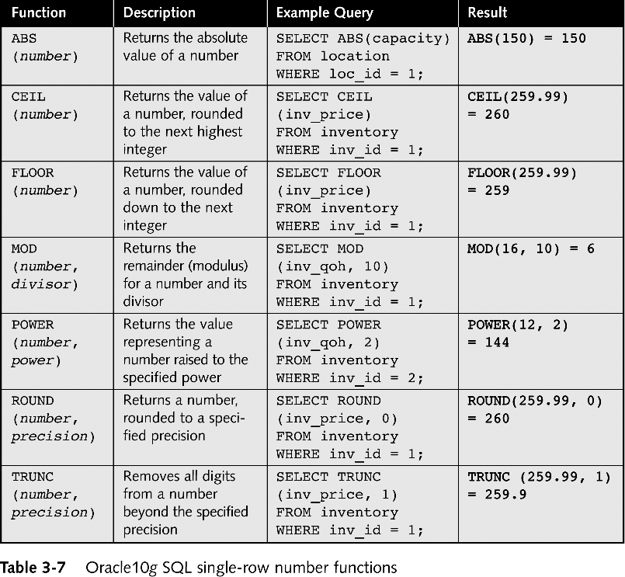
Single-row Number Functions

Slide 3
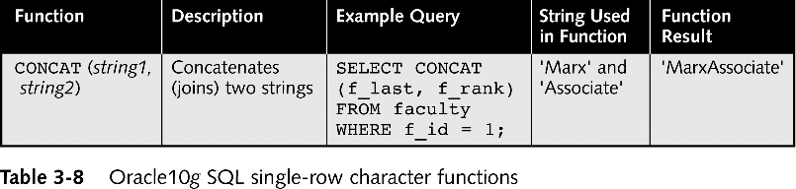
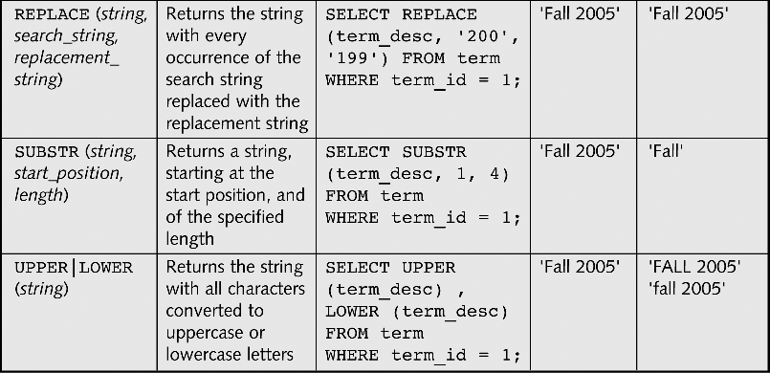
Single-row Character Functions
Continued on next slide

Slide 4
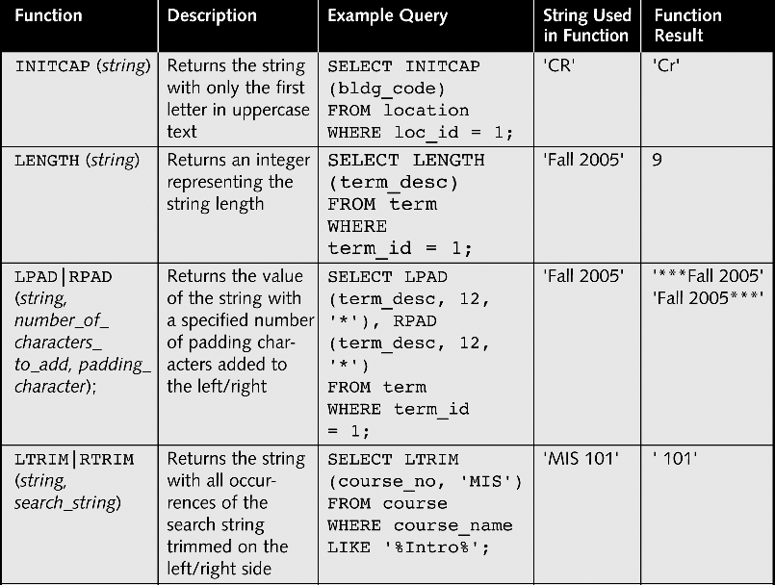
Single-row Character Functions

Slide 5
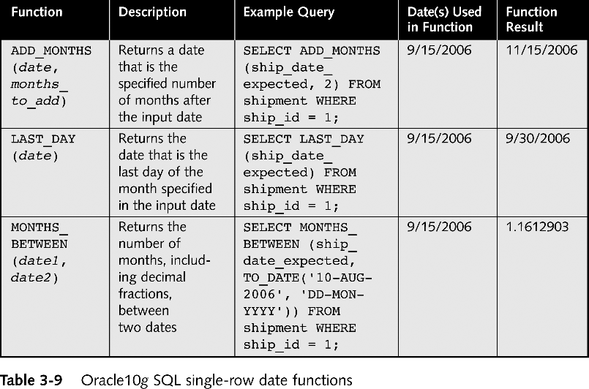
Single-row Date Functions

Slide 6
Aggregate or Group Functions
Aggregate functions return a single result row based on groups of rows, rather than on single rows.
Can’t mix aggregate results and single row results.
Aggregate functions take some type of expression. The expression is usually a column name, but it can also be a constant or calculated value.
Aggregates cannot be used as conditions in the WHERE clause.

Slide 7
Aggregate and NULLs
If there are any null values in the column on which the aggregate function is operating, they are ignored for the purpose of the function.
  The exception to this rule is COUNT(*), which counts each row, whether a column value is NULL. If no rows meet the query conditions, COUNT returns 0. The other functions all return NULL.
  can use the NVL function in the argument of an aggregate function to substitute a value for a null.
  COUNT never returns null, but returns either a number or zero

Slide 8
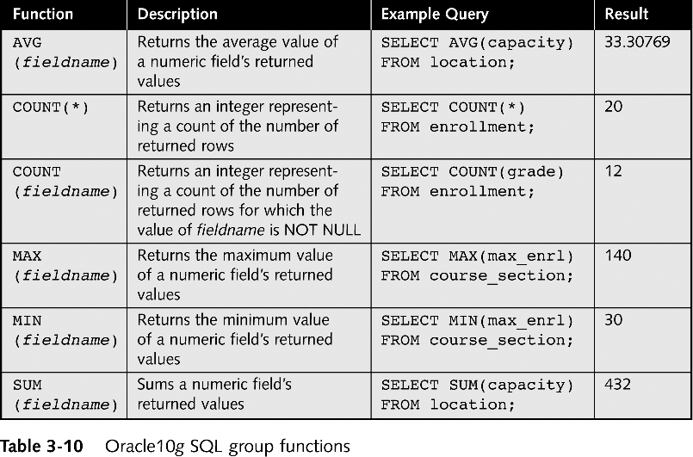
Group Functions

Slide 9
GROUP BY and HAVING clauses
Use the GROUP BY clause to specify grouping of rows.
Specify the GROUP BY clause if you want Oracle to group the selected rows based on the value of the expressions for each row and return a single row of summary information for each group.
Use the HAVING clause to restrict the groups of returned rows to those groups for which the specified condition is TRUE. If you omit this clause, then Oracle returns summary rows for all groups.

Slide 10
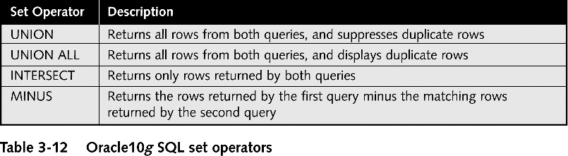
Set Operators to Combine Query Results

